Slide 1
Year Project
Zihan Liu
Mike Rizakis

Slide 2
What did we do
Better version of Edge Detection
Convolution Mask of Image Sharpening
Critical Detection (fail)
Image Histogram
Project : Image Thresholding
Project was image rotation, storage of this FPGA is only 8kB.
Fix point Threshold Image controlled by mouse
Threshold rate control by histogram

Slide 3
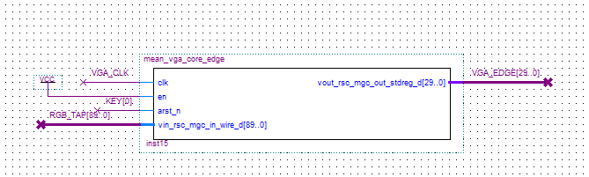
Edge Detection

Slide 4
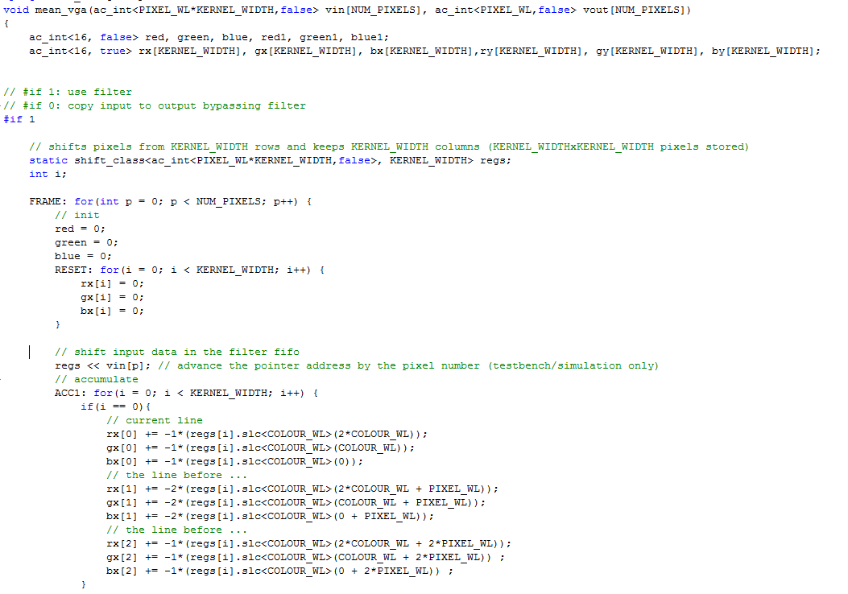

Slide 5
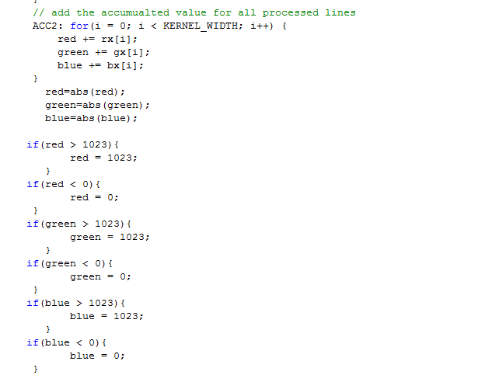

Slide 6
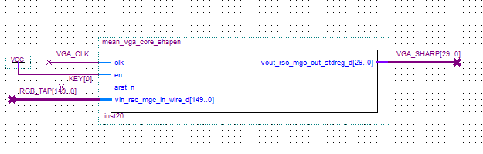
Image sharpening

Slide 7
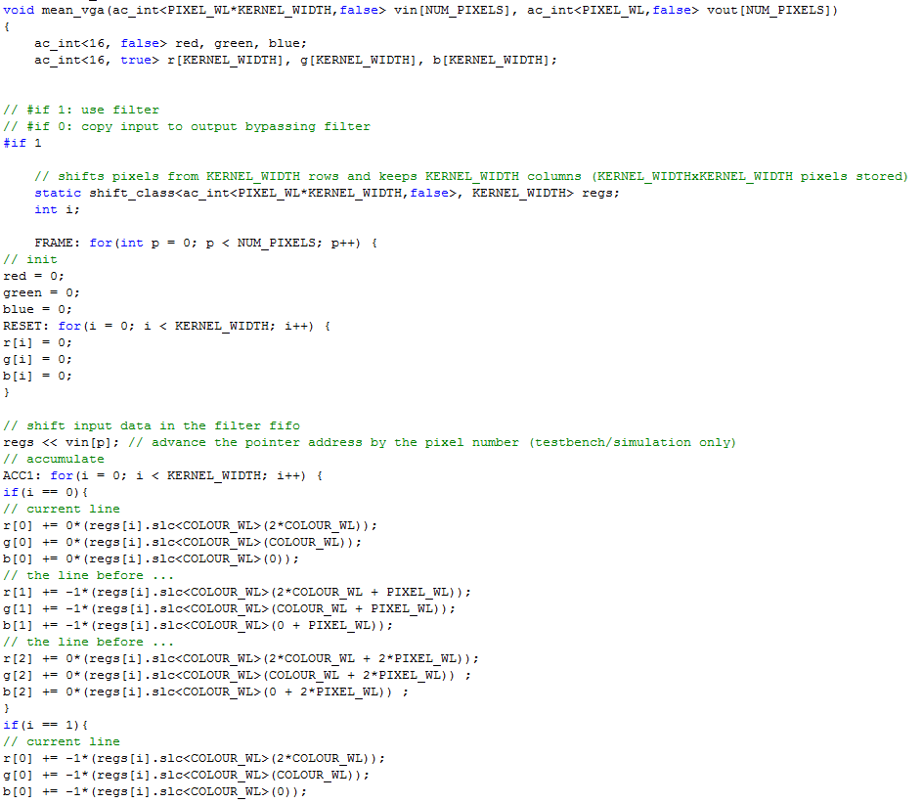

Slide 8
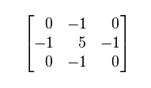

Slide 9
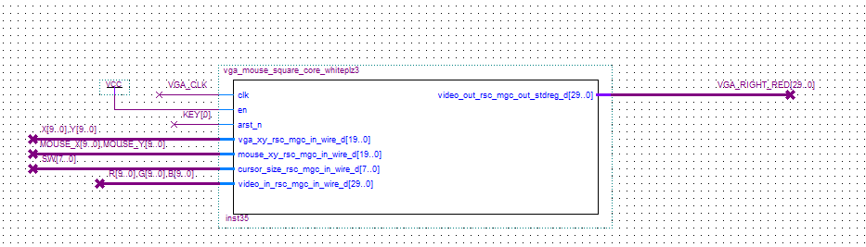
Critical Detection

Slide 10
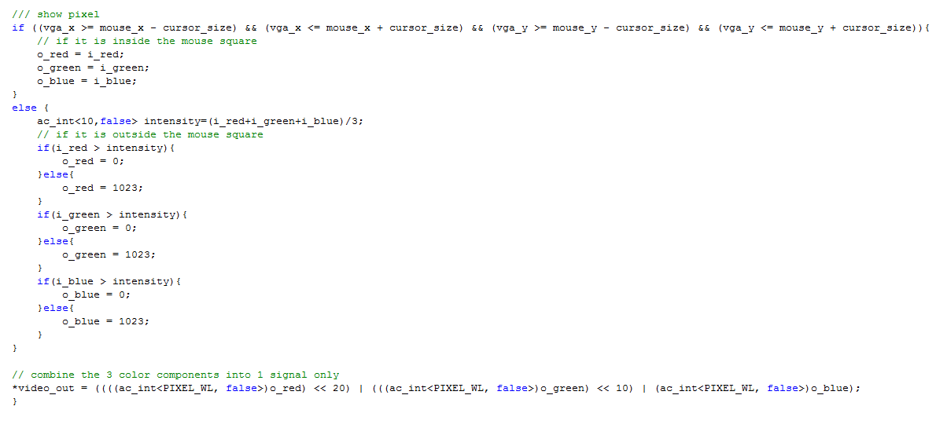

Slide 11
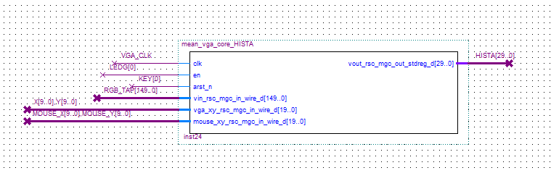
Image Histogram

Slide 12
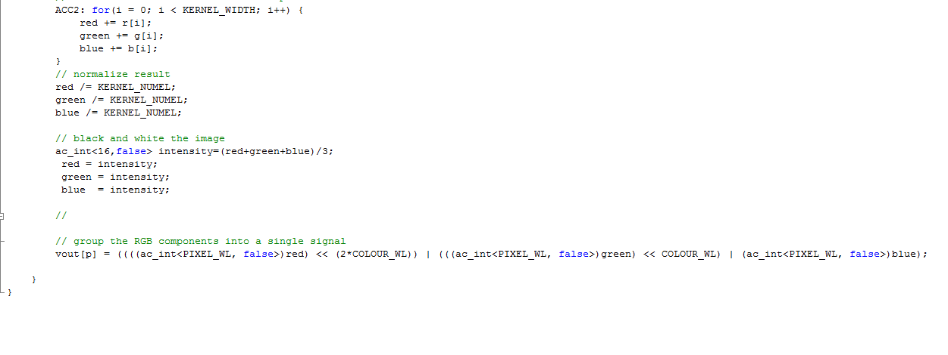

Slide 13
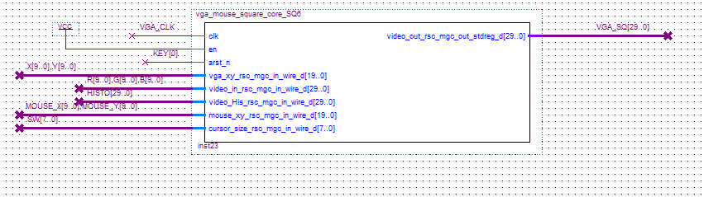
Threshold image

Slide 14
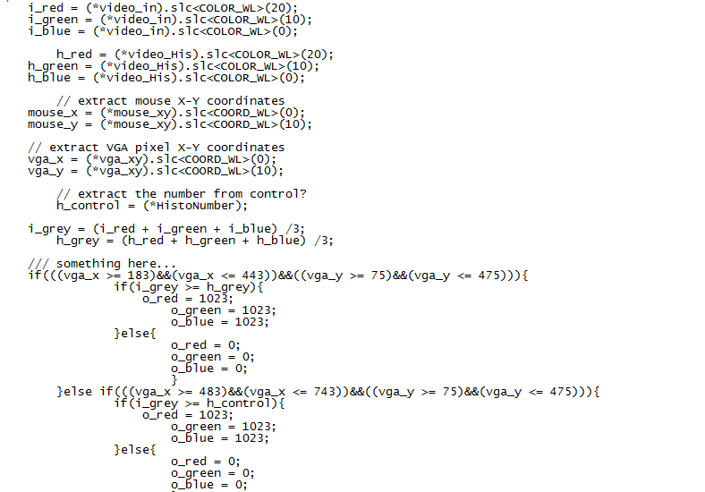

Slide 15
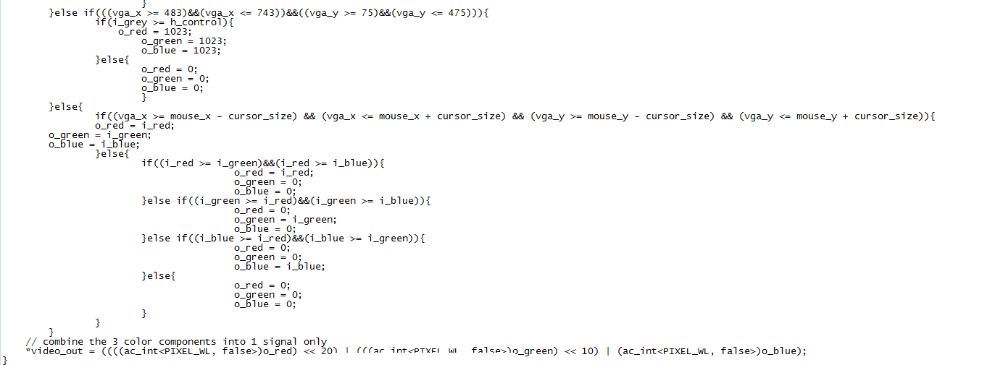

Slide 16
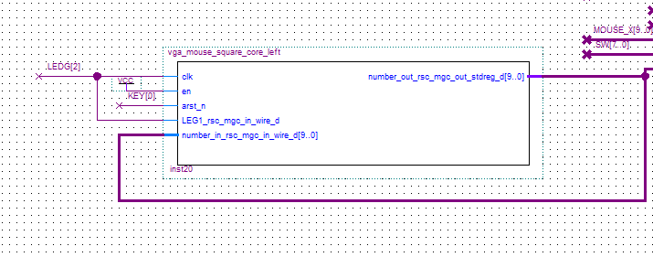
Mouse control

Slide 17
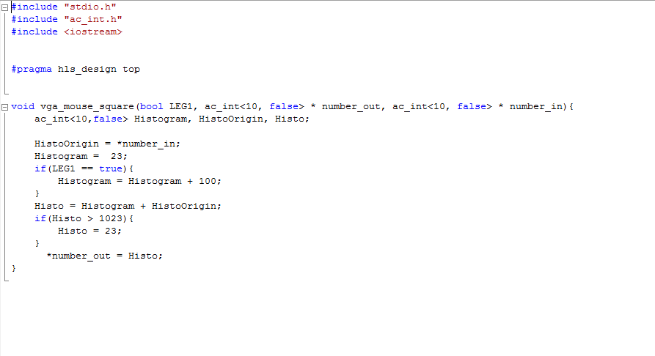

Slide 18
DE0
D5M
Threshold
Block
Throughput: 1 pixel
Latency: 2 cycles
Mouse
Controler

Slide 19
Compare to
Histogram that calculated then threshold the image
MOUSE_xy
VGA_XY
VGA_XY
Histogram
Calculator
LEFT BLOCK
Main
Block
Compare to
Histogram that updated then threshold the image
RIGHT BLOCK
ELSE
Histogram
Updater
Compare the
RGB then given out the colour with most energy
Pixel
Energy
Compare
Output the real image

Slide 20
Thanks

